Slide 1
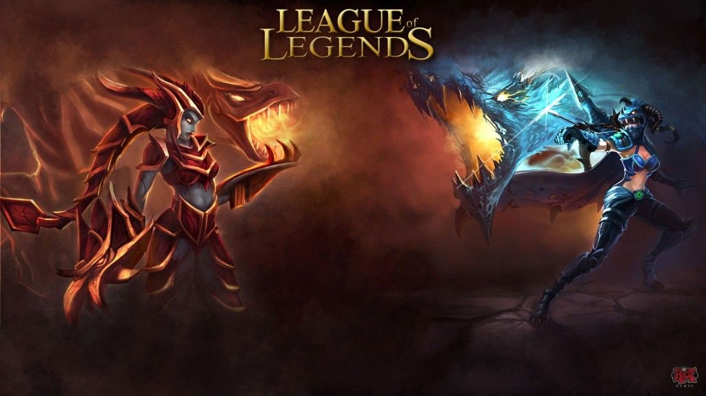

MOBA with Unity

Slide 2
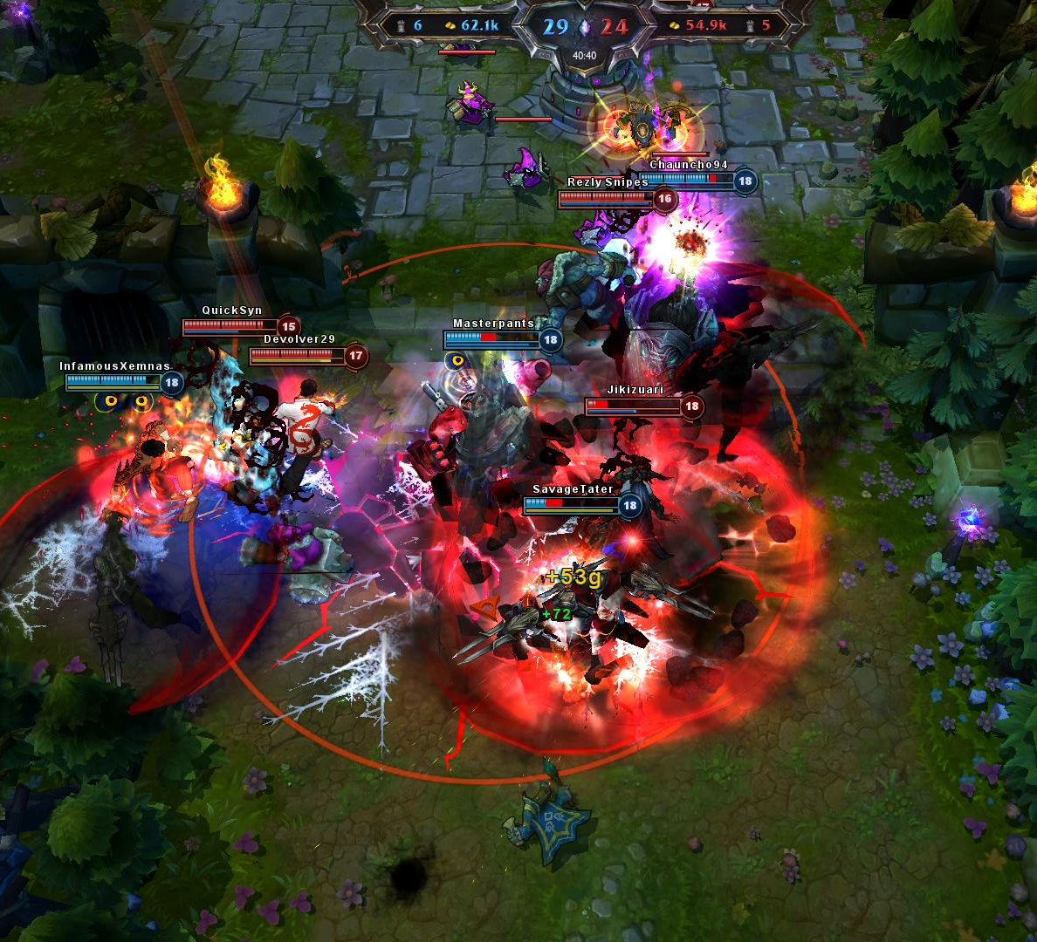
The idea
A MOBA style game
5v5
Destroy your opponent
Team game
Acquire all the objectives
Win the game

Slide 3
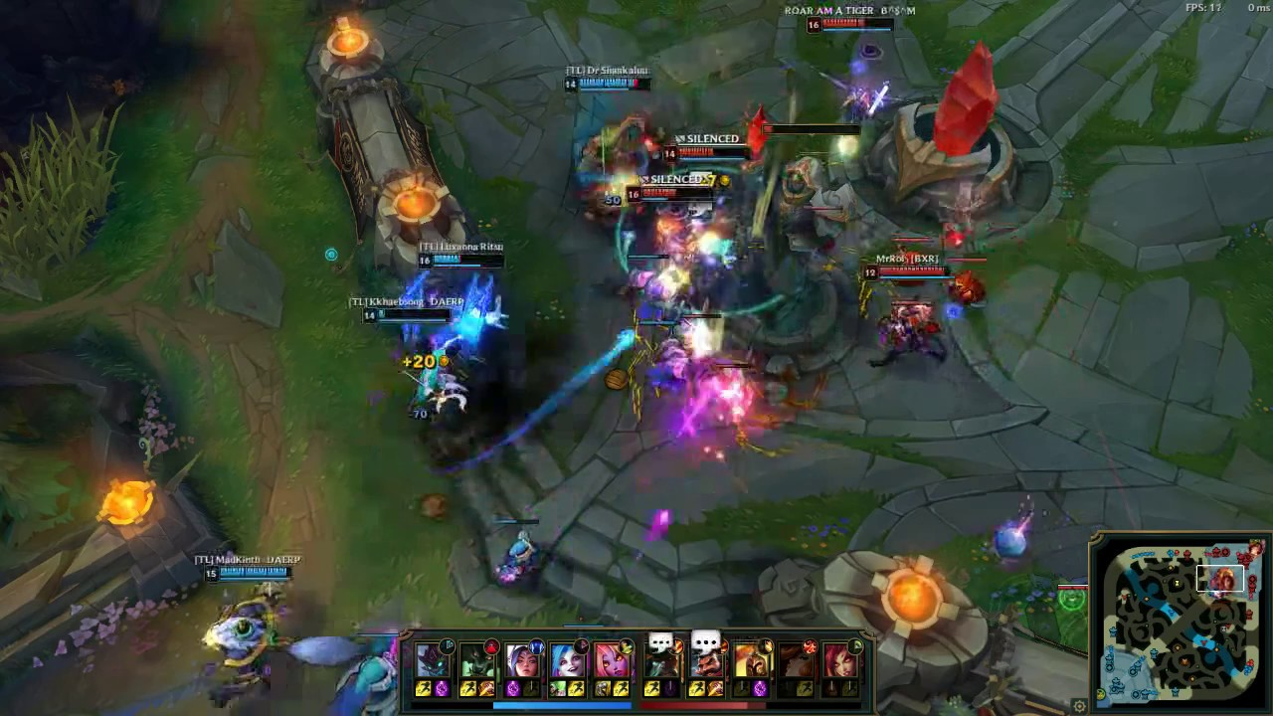
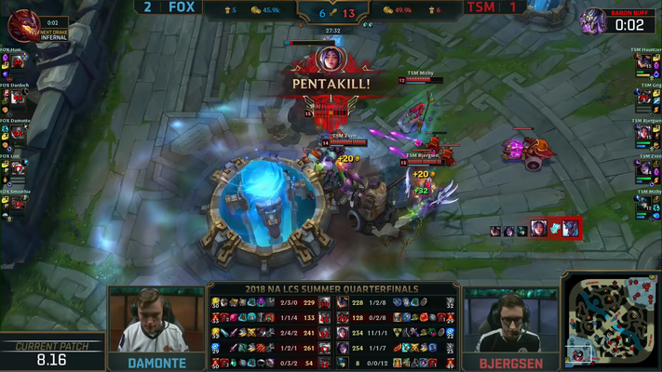
The pertinence of this idea
It’s a game
Unity
C# - Useful in other fields
Learn about multiplayer in Unity
Esports (competitive $$)
Possibility to port on mobile

Slide 4
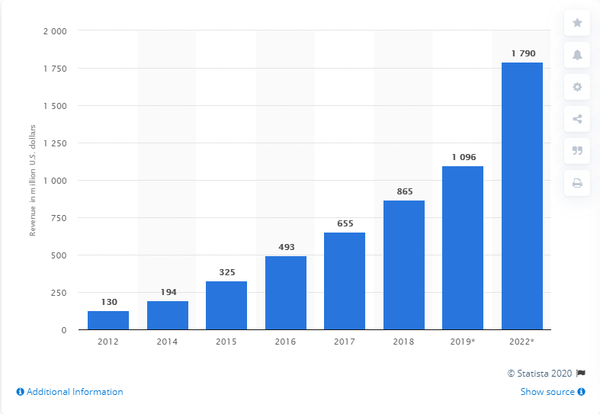
eSports market revenue 2012-2022
https://www.statista.com/statistics/490522/global-esports-market-revenue/

Slide 5
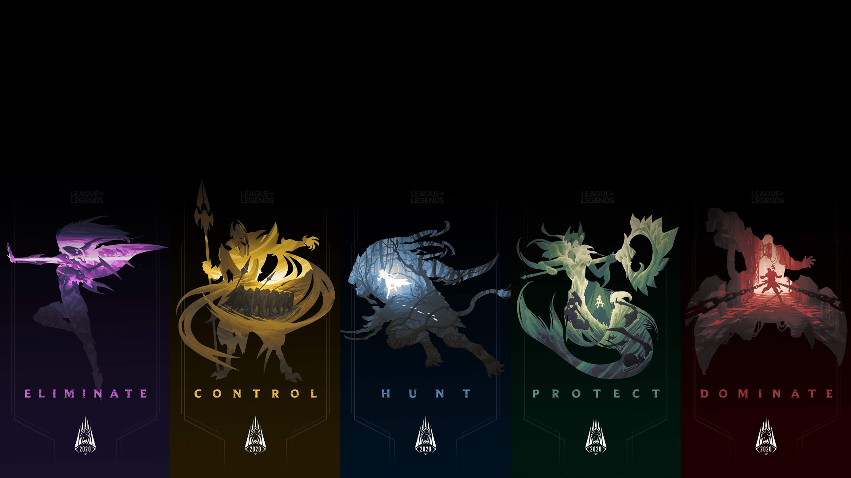
functionalities

Slide 6
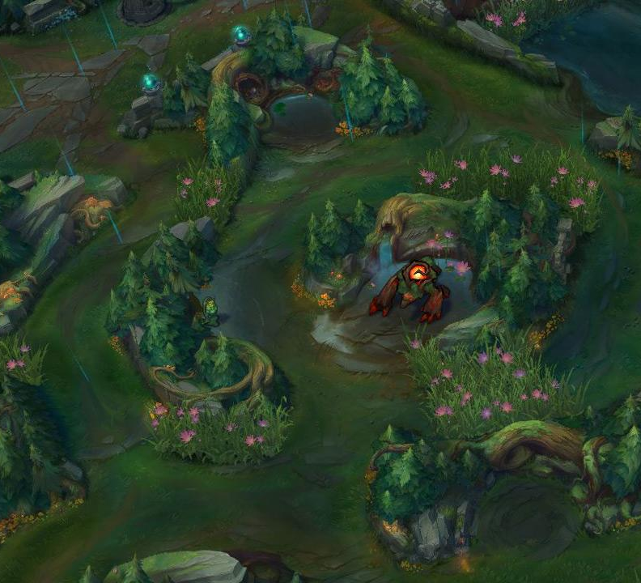
Menu
Lobby
Play with your friends
Kill monsters
Kill bosses with your team
Buy items, get stronger (shop)
Synergy (champions)
Destroy objectives
High skill cap

Slide 7
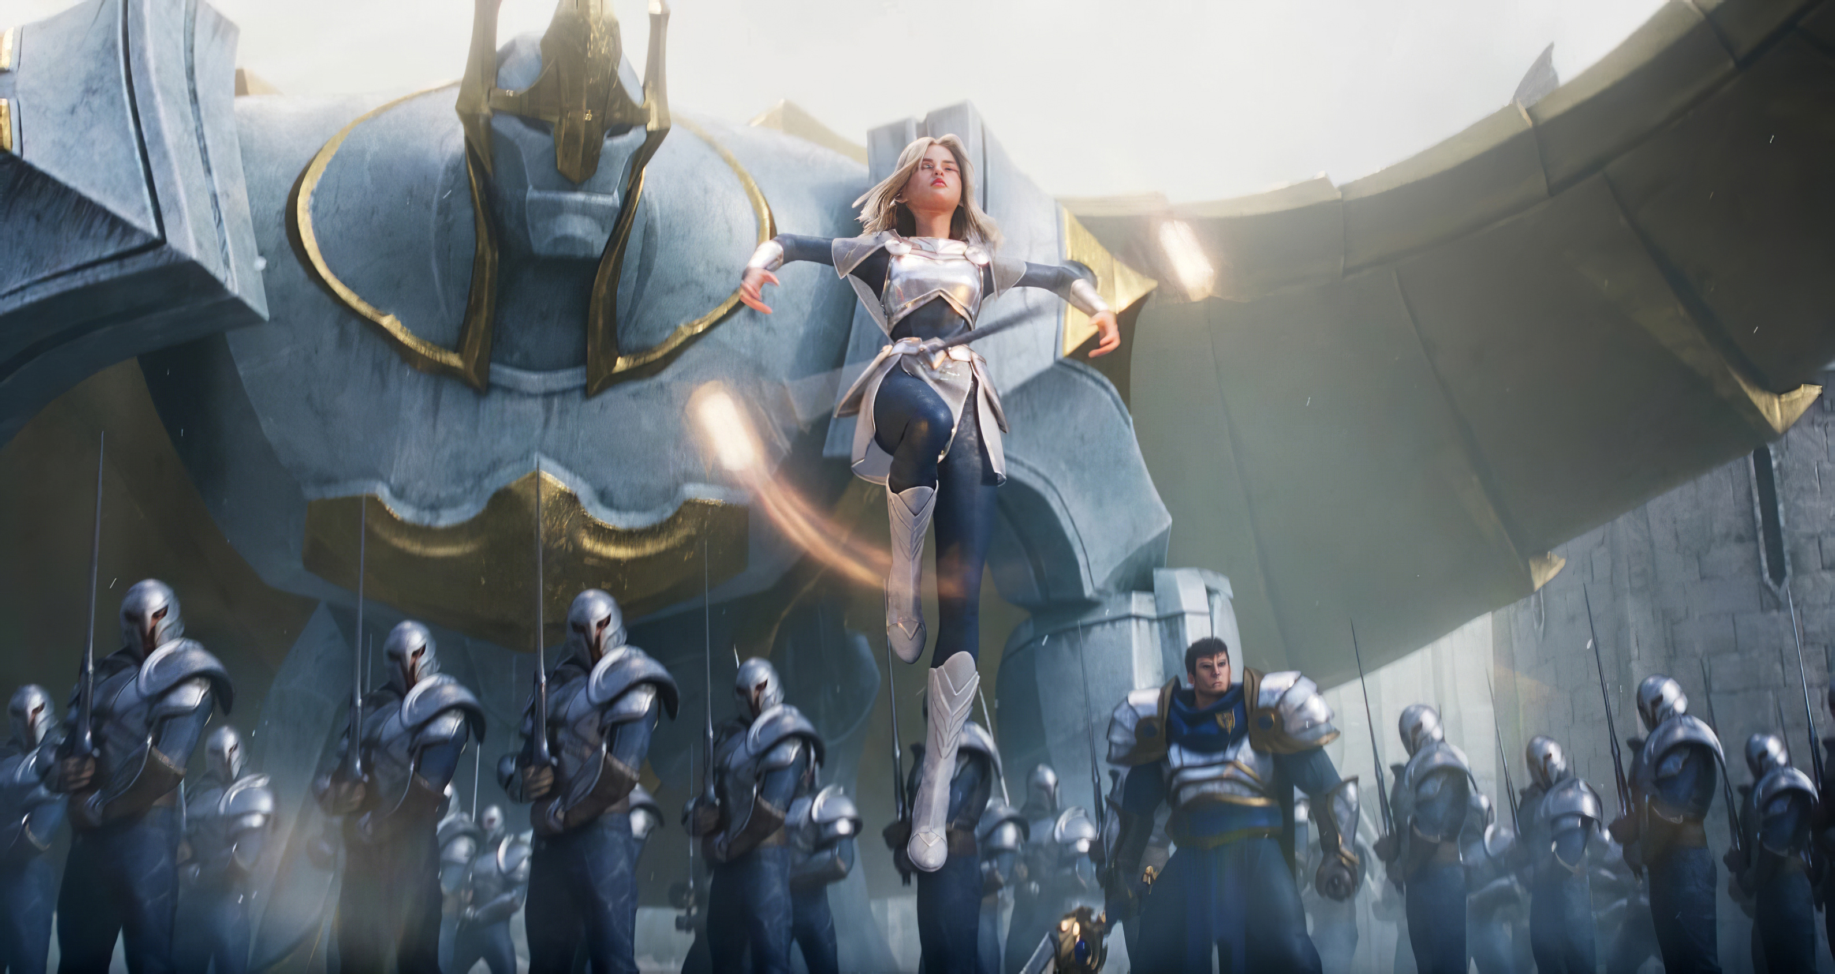
Choice of technology
Unity C# / Unreal C++ (Future usage?)
Documentation / knowledge
Speed of development Unity/Unreal
Time frame
Engine updates, what’s to come

Slide 8
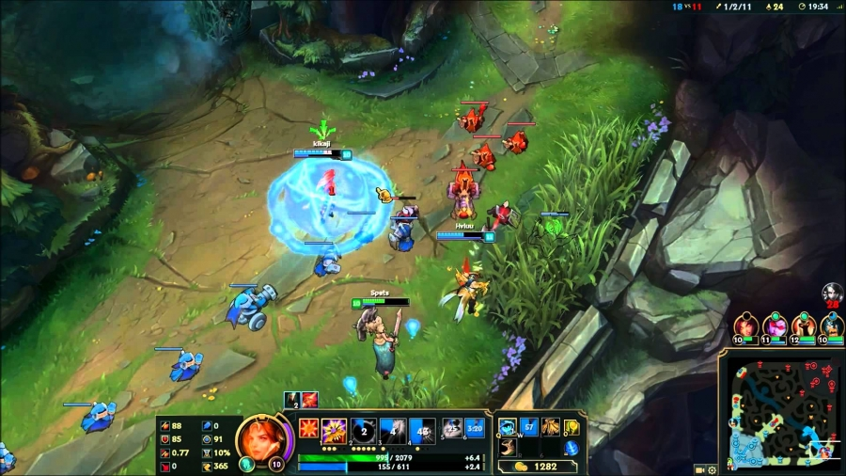
diagrams

Slide 9
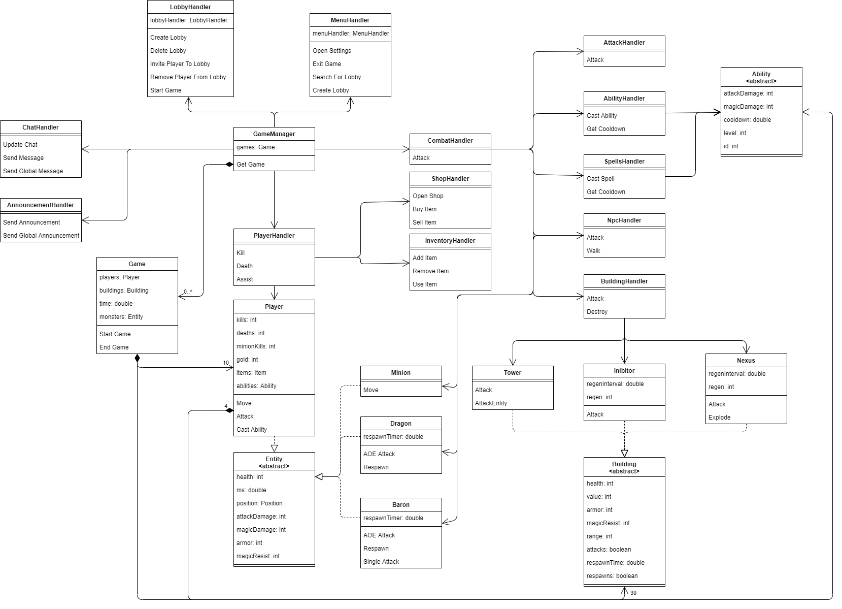
Class diagram

Slide 10
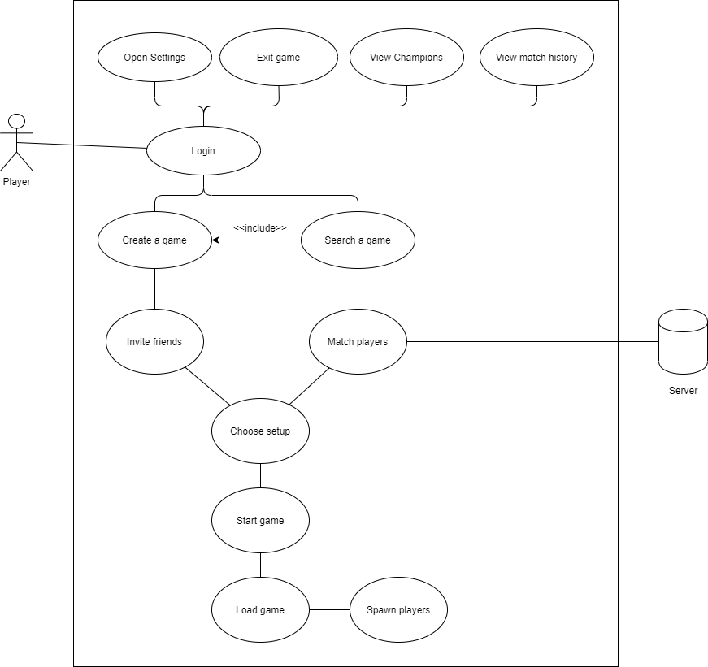
USE case diagram

Slide 11
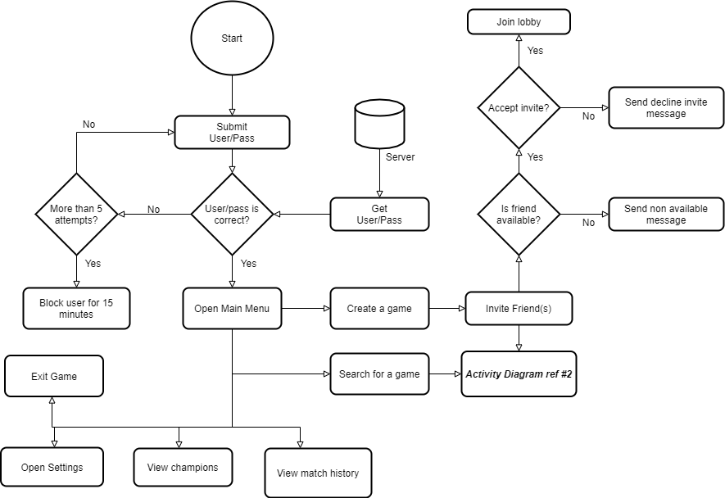
Activity Diagram #1

Slide 12
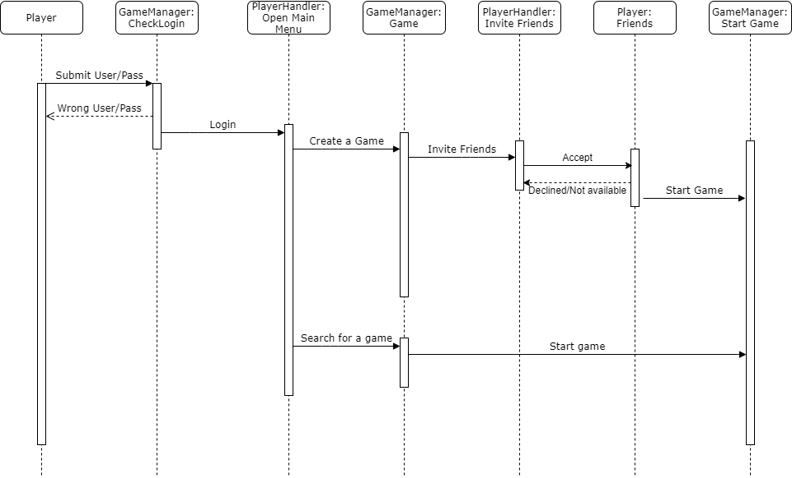
Sequence diagram #1

Slide 13
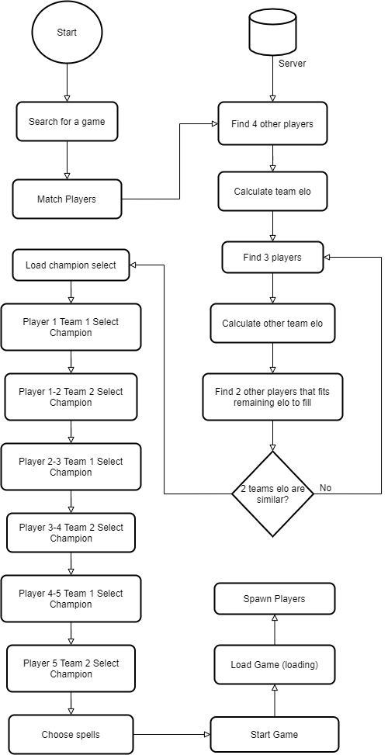
Activity Diagram #2

Slide 14
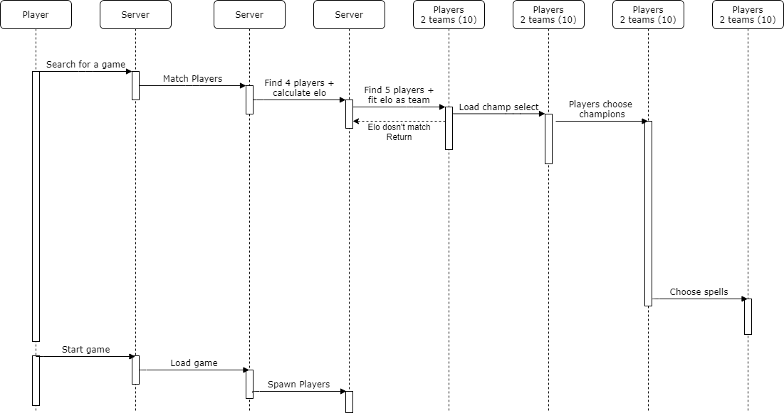
Sequence diagram #2

